Slide 1
Advanced Bean Configuration

Slide 2
Advanced Bean Configuration
BeanPostProcessor
FactoryBean
SpEL
Proxies
Profiles

Slide 3
Bean Lifecycle
Instantiation
Populate Properties BeanNameAware BeanFactoryAware
Pre Initialization - BeanPostProcessors InitializeBean
initMethod
Post Initialization - BeanPostProcessors

Slide 4





FactoryBean
Builds on initMethod concept
Factory Method Pattern
Legacy Code
Contract without Constructor
Static Methods

Slide 5
@Value("#{ T(java.lang.Math).random() * 100.0 }") private double seedNum;
SpEL
Manipulate Object Graph Evaluate at Runtime Configuration

Slide 6
Spring AOP Proxies
ProxyFactory factory = new ProxyFactory(new SimplePojo()); factory.adddInterface(Pojo.class);
factory.addAdvice(new RetryAdvice()); factory.setExposeProxy(true);
Pojo pojo = (Pojo) factory.getProxy();
// this is a method call on the proxy!
pojo.foo();
Spring Utilizes Proxies
When?
@Transactional

Slide 7
@Repository("speakerRepository") @Profile("dev")
public class HibernateSpeakerRepositoryImpl implements SpeakerRepository
Bean Profiles
Adapt Environments Runtime Configuration

Slide 9
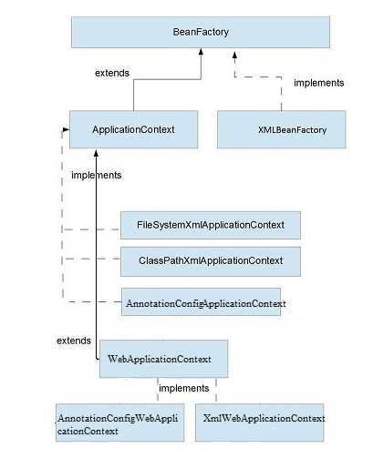
Bean Factory Interface

Slide 10
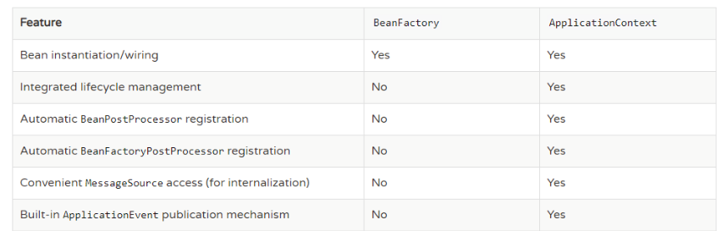
Summary of Spring IoC Containers

Slide 11

Assisted Practice
Spring BeanFactory Container

Slide 12
Assisted Practice
Spring ApplicationContext Container

Slide 13
Bean Lifecycle
FactoryBean SpEL
Summary
Proxies
Profiles IoC Containers

